Slide 1




Safety Shielding under Delayed Observation
Filip Cano Córdoba, Alexander Palmisano,
Martin Fränzle, Roderick Bloem, Bettina Könighofer
06 October 2023
This work has received funding from the European Union’s Horizon 2020 research and innovation programme under grant agreement Nº 956123 - FOCETA.
Notes:
Safety of autonomous agents in real-world
One aspect often overlooked
Unexpected safety violations

Slide 2
Overview
Safety Shielding under Delayed Observation Filip Cano Córdoba
Introduction
Safety shields: regular shields, delay-resilient shields
Experiments: collision avoidance in Carla
Safety shields: Maximizing delay-resilience in post-shields
Experiments: chase game in a gridworld
Conclusion
📖 Cano Córdoba et al., Safety Shielding under Delayed Observation, ICAPS 2023
Notes:
In the video, a car is driving in the road, the shield icon indicates when the shield is active.
Shield brakes at distance to closest pedestrian
Worst-case assumption of the pedestrian
Tradeoff between resilience and performance

Slide 3
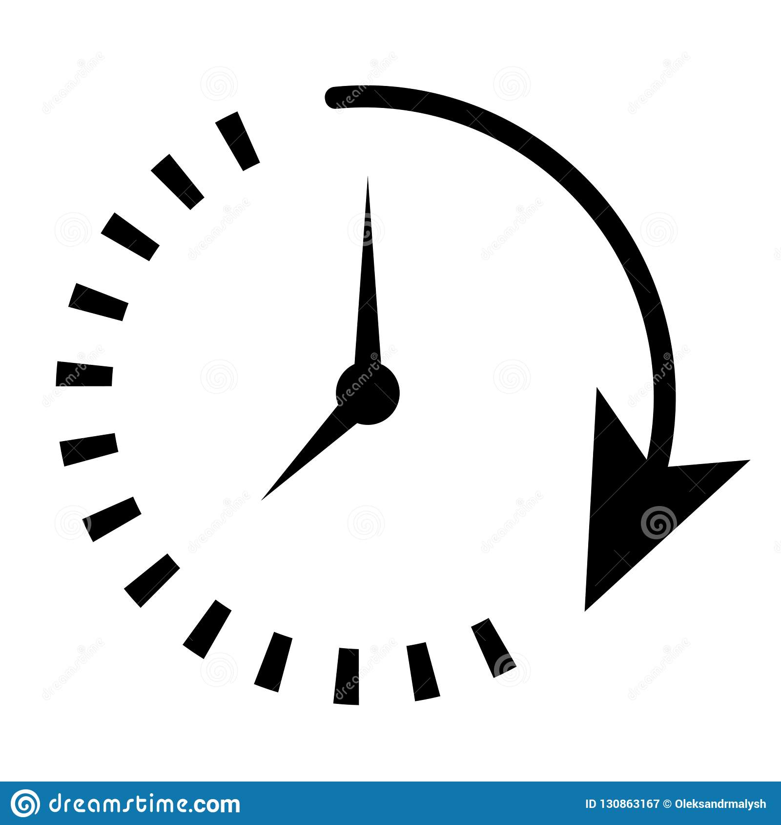


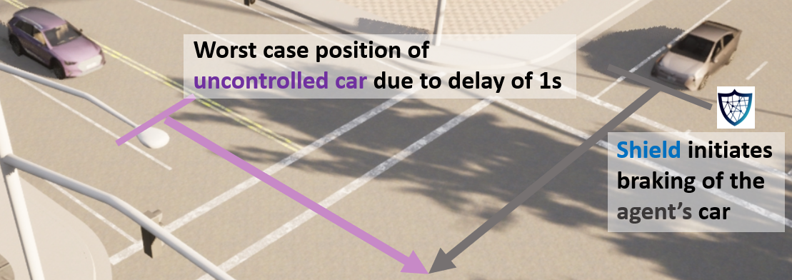
Runtime Safety Enforcement with Shields
Safety Shielding under Delayed Observation Filip Cano Córdoba
Shields guarantee safety, with minimal interference
delayed
observation
Environment
Agent
But information may be delayed.
safe
Contributions
Adapt shield synthesis to work with delayed observations.
First implementation of shielding in car simulator
action
📖 Könighofer et al., Safe Reinforcement Learning via Shielding, AAAI 2018
Notes:
Agent operating in an environment.
Shileds are runtime enforcers
What if delay
In our paper…

Slide 4
Overview
Safety Shielding under Delayed Observation Filip Cano Córdoba
Introduction
Safety shields: regular shields, delay-resilient shields
Experiments: collision avoidance in Carla
Safety shields: Maximizing delay-resilience in post-shields
Experiments: chase game in a gridworld
Conclusion
📖 Cano Córdoba et al., Safety Shielding under Delayed Observation, ICAPS 2023
Notes:
In the video, a car is driving in the road, the shield icon indicates when the shield is active.
Shield brakes at distance to closest pedestrian
Worst-case assumption of the pedestrian
Tradeoff between resilience and performance

Slide 5
Runtime Safety Enforcement with Shields
Safety Shielding under Delayed Observation Filip Cano Córdoba
Shields
Guarantee correctness, while being minimally interfering
Can be attached after (post) or before (pre) the agent
delayed
delayed
observation
observation
action
Environment
Agent
Environment
safe actions
Agent
safe
action
safe
action
Post-Shield
Pre-Shield
📖 Könighofer et al., Safe Reinforcement Learning via Shielding, AAAI 2018
Notes:
Agent operating in an environment.
Shileds are runtime enforcers
What if delay
In our paper…

Slide 6
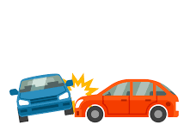
Shield Synthesis - Safety Games
Safety Shielding under Delayed Observation Filip Cano Córdoba
observations
Player
Player
a, b
Environment
Agent
s₆
s₇
actions
b
s₅
a
s₄
s₉
s₁₀
b
b
s₈
a
s₀
s₁
s₂
s₃
a
a
b
📖 Thomas, On the synthesis of strategies in infinite games, STACS 1995
Notes:
Let me give you some insight
Game graph, 2 players, by turns, infinite plays
Blue states belong to the agent
Red states belong to the environment
Bad states
The agent wins…
Shields are built from wining strategy…

Slide 7

Shield Synthesis - Safety Games
Safety Shielding under Delayed Observation
X
observations
s₆
a, b
Player
Player
s₇
Environment
Agent
X
actions
b
s₅
a
s₄
s₉
s₁₀
b
a
a
a
s₁ :
s₃ :
s₅ :
s₉ :
,
,
,
b
b
b
b
s₈
a
X
s₀
s₁
s₂
s₃
a
a
b
📖 Thomas, On the synthesis of strategies in infinite games, STACS 1995

Slide 8
Shield Synthesis - Delayed Safety Games
Safety Shielding under Delayed Observation Filip Cano Córdoba
delayed
observations
Player
Player
a, b
Environment
Agent
s₆
s₇
actions
b
s₅
a
s₄
s₉
s₁₀
b
b
s₈
a
s₀
s₁
s₂
s₃
a
a
b
📖 Chen et al., Indecision and delays are the parents of failure. Acta Informatica, 2020
Notes:
Solve the game in delayed mode
In normal mode…
In delayed mode, the agent observes the past, needs to act in the present, planning for the future
We took their algorithm and made if faster

Slide 9
Overview
Safety Shielding under Delayed Observation Filip Cano Córdoba
Introduction
Safety shields: regular shields, delay-resilient shields
Experiments: collision avoidance in Carla
Safety shields: Maximizing delay-resilience in post-shields
Experiments: chase game in a gridworld
Conclusion
📖 Cano Córdoba et al., Safety Shielding under Delayed Observation, ICAPS 2023
Notes:
In the video, a car is driving in the road, the shield icon indicates when the shield is active.
Shield brakes at distance to closest pedestrian
Worst-case assumption of the pedestrian
Tradeoff between resilience and performance

Slide 10
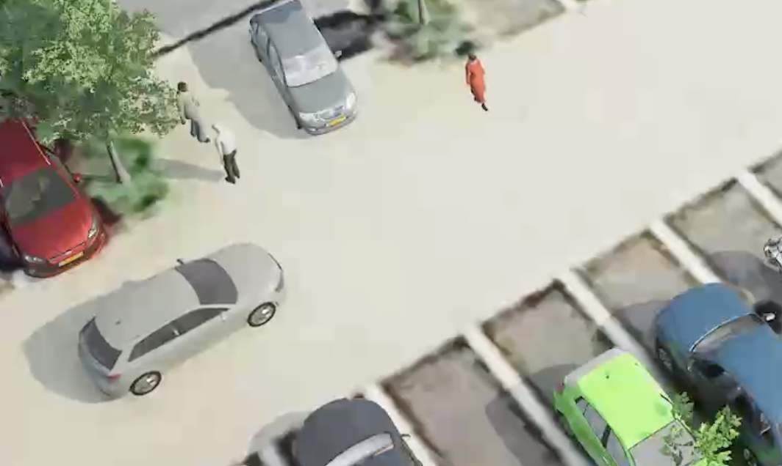
Shielding Against Collisions with Pedestrians in Carla
Safety Shielding under Delayed Observation Filip Cano Córdoba
Model of the environment
Ego car velocity.
Relative distances from car to pedestrian: dist_{x} , dist_{y}.
dist_{y}
dist_{x}
Controller
We modified Carla‘s own traffic manager agent.
📖 Dosovitskiy et al., Carla, an Open Urban Driving Simulator, CoRL 2017
Notes:
I promised you some videos…
Only collisions with pedestrians.
Model velocity
Model 2 distances
Carla’s basic controller

Slide 11
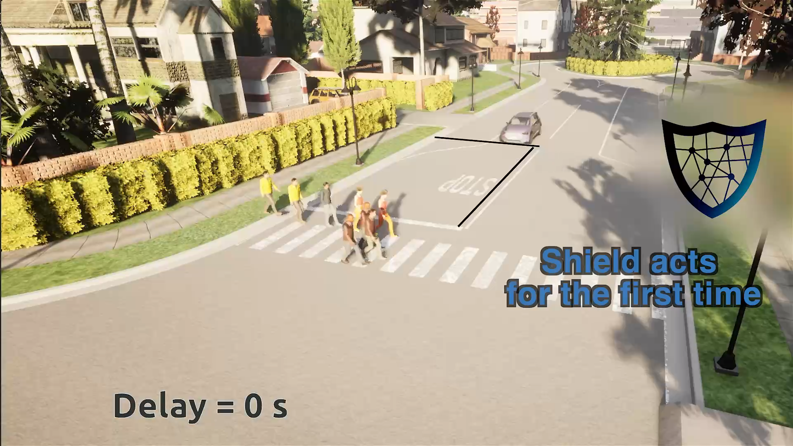
Shielding Against Collisions with Pedestrians in Carla
Safety Shielding under Delayed Observation Filip Cano Córdoba
📖 Dosovitskiy et al., Carla, an Open Urban Driving Simulator, CoRL 2017
Notes:
In the video, a car is driving in the road, the shield icon indicates when the shield is active.
Shield brakes at distance to closest pedestrian
Worst-case assumption of the pedestrian
Tradeoff between resilience and performance

Slide 12
Shielding Against Collisions with Pedestrians in Carla
Safety Shielding under Delayed Observation Filip Cano Córdoba
For longer delay, shield needs to act earlier
Notes:
In the video, a car is driving in the road, the shield icon indicates when the shield is active.
Shield brakes at distance to closest pedestrian
Worst-case assumption of the pedestrian
Tradeoff between resilience and performance

Slide 13
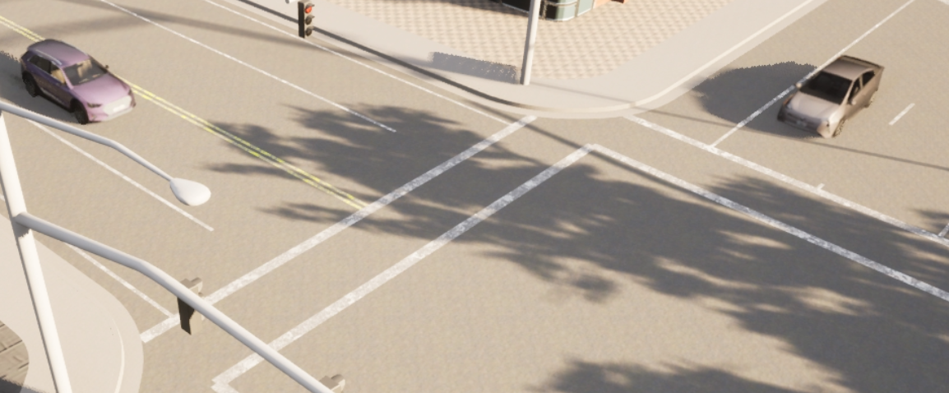
Shielding Against Collisions with Cars in Carla
Safety Shielding under Delayed Observation Filip Cano Córdoba
Model of the environment
Ego car and other car velocity.
Relative distances from each car to intersection dist_{ego} , dist_{other}.
Controller
We modified Carla‘s own traffic manager agent.
dist_{ego}
dist_{other}
📖 Dosovitskiy et al., Carla, an Open Urban Driving Simulator, CoRL 2017
Notes:
I promised you some videos…
Only collisions with pedestrians.
Model velocity
Model 2 distances
Carla’s basic controller

Slide 14
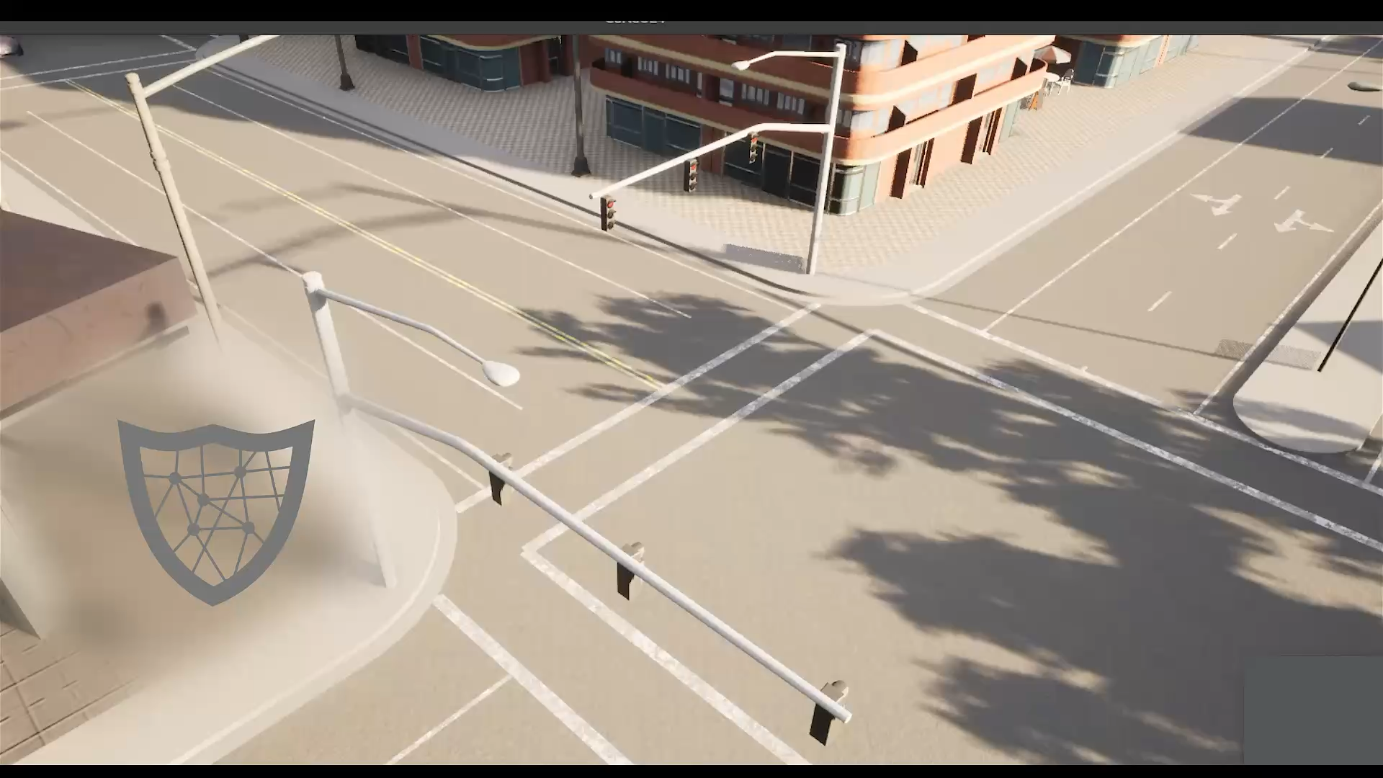
Shielding Against Collisions with Cars in Carla
Safety Shielding under Delayed Observation Filip Cano Córdoba
📖 Dosovitskiy et al., Carla, an Open Urban Driving Simulator, CoRL 2017
Notes:
In the video, a car is driving in the road, the shield icon indicates when the shield is active.
Shield brakes at distance to closest pedestrian
Worst-case assumption of the pedestrian
Tradeoff between resilience and performance

Slide 15
Shielding Against Collisions with Cars in Carla
Safety Shielding under Delayed Observation Filip Cano Córdoba
With longer delay:
Larger distance to enforce safety specification
Intermitent behavior
📖 Dosovitskiy et al., Carla, an Open Urban Driving Simulator, CoRL 2017
Notes:
In the video, a car is driving in the road, the shield icon indicates when the shield is active.
Shield brakes at distance to closest pedestrian
Worst-case assumption of the pedestrian
Tradeoff between resilience and performance

Slide 16
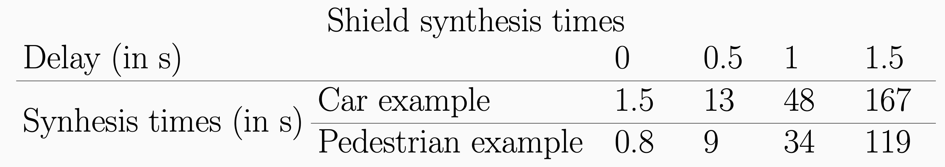
Shielding Against Collisions in Carla : Synthesis Times
Safety Shielding under Delayed Observation Filip Cano Córdoba
Notes:
In the video, a car is driving in the road, the shield icon indicates when the shield is active.
Shield brakes at distance to closest pedestrian
Worst-case assumption of the pedestrian
Tradeoff between resilience and performance

Slide 17
Overview
Safety Shielding under Delayed Observation Filip Cano Córdoba
Introduction
Safety shields: regular shields, delay-resilient shields
Experiments: collision avoidance in Carla
Safety shields: Maximizing delay-resilience in post-shields
Experiments: chase game in a gridworld
Conclusion
📖 Cano Córdoba et al., Safety Shielding under Delayed Observation, ICAPS 2023
Notes:
In the video, a car is driving in the road, the shield icon indicates when the shield is active.
Shield brakes at distance to closest pedestrian
Worst-case assumption of the pedestrian
Tradeoff between resilience and performance

Slide 18
Runtime Safety Enforcement with Shields
Safety Shielding under Delayed Observation Filip Cano Córdoba
Shields
Guarantee correctness, while being minimally interfering
Can be attached after (post) or before (pre) the agent
delayed
delayed
observation
observation
action
Environment
Agent
Environment
safe actions
Agent
safe
action
safe
action
Post-Shield
Pre-Shield
📖 Könighofer et al., Safe Reinforcement Learning via Shielding, AAAI 2018
Notes:
Agent operating in an environment.
Shileds are runtime enforcers
What if delay
In our paper…

Slide 19
Two Criteria For Post-Shields
Safety Shielding under Delayed Observation Filip Cano Córdoba
delayed
observation
Post shield overwrites unsafe actions
Environment
Agent
Goal
Choice minimizes shield intervention
Without much cost overhead
unsafe action
safe
action
Which one ?
Delay-Resilient Post-Shields
Put the safety game in a state that allows most delay
Minimizes interventions caused by delay
Very expensive to compute
Robust-Safety Post-Shields
Put the safety game in a state furthest away from unsafe region
Approximation to delay-resilience
Cheap to compute

Slide 20
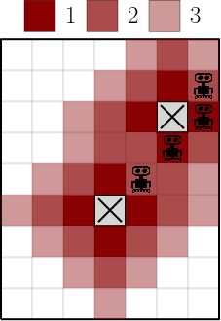
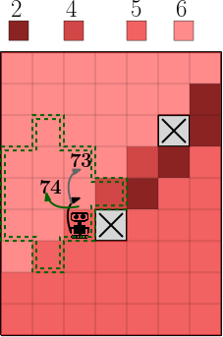
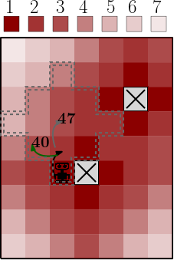
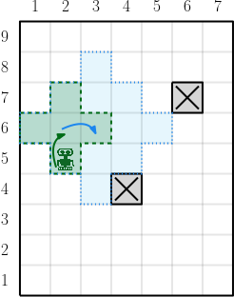
Delay-resilience vs. Robust-safety: Example
Safety Shielding under Delayed Observation Filip Cano Córdoba
Moves: Up, Down, Right, Left, None
📖 Cano Córdoba et al., Safety Shielding under Delayed Observation, ICAPS 2023

Slide 21
Overview
Safety Shielding under Delayed Observation Filip Cano Córdoba
Introduction
Safety shields: regular shields, delay-resilient shields
Experiments: collision avoidance in Carla
Safety shields: Maximizing delay-resilience in post-shields
Experiments: chase game in a gridworld
Conclusion
📖 Cano Córdoba et al., Safety Shielding under Delayed Observation, ICAPS 2023
Notes:
In the video, a car is driving in the road, the shield icon indicates when the shield is active.
Shield brakes at distance to closest pedestrian
Worst-case assumption of the pedestrian
Tradeoff between resilience and performance

Slide 22
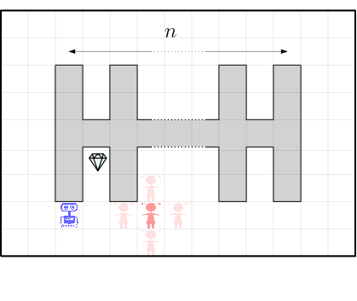
Safety Shields – Chase Game in a Gridworld
Safety Shielding under Delayed Observation Filip Cano Córdoba
Gridworld experiments:
Robot tries to get treasure
Kid tries to collide with robot
Collision ends the game
Results
Faster implementation than [Chen et al.]
Different behavior for different types of shields
Pre-shields obtain more score
Post shields interrupt less
📖 Chen et al., Indecision and delays are the parents of failure. Acta Informatica, 2020

Slide 23
Safety Shields – Shield Synthesis Cost
Safety Shielding under Delayed Observation Filip Cano Córdoba

Slide 24
Safety Shields – Gridworld Performance
Safety Shielding under Delayed Observation Filip Cano Córdoba

Slide 25

Contributions & Future Work
Safety Shielding under Delayed Observation Filip Cano Córdoba
Contributions
Adapt shield synthesis to work with delayed observations.
First implementation of shielding in car simulator
Future/in-progress work
Probabilistic models
Continuous-state models
https://github.com/filipcano/safety-shields-delayed
This work has received funding from the European Union’s Horizon 2020 research and innovation programme under grant agreement Nº 956123 - FOCETA.
Notes:
With this I finish my presentation of this paper, that is a step forward in bringing shielding closer to real applications.

Slide 26
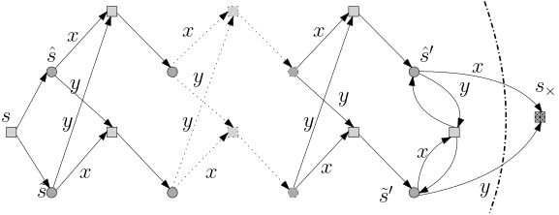
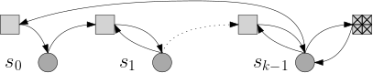
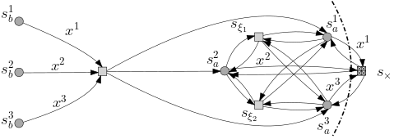
Delay-resilience and Robust safety can be arbitrarily different
Safety Shielding under Delayed Observation Filip Cano Córdoba
Theorem: For all 𝛿 > 0 and all k > 0, exists G_{k,𝛿} such that
𝜙_{dr}(G_{k,𝛿}) > 𝛿 and 𝜙_{rs}(G_{k,𝛿}) < 𝛿 + k + 1
Theorem: For all 𝛿 > 0 and all k > 0, exists G_{k,𝛿} such that
𝜙_{dr}(G_{k,𝛿}) > 𝛿 + k and 𝜙_{rs}(G_{k,𝛿}) < 𝛿
Base case
Induction step

Slide 27
Shield Synthesis - Delayed Safety Games
Contributions: Safety Shielding under Delayed Observation
delayed
observations
X
Player
Player
s₆
a, b
Environment
Shield
s₇
actions
X
b
s₅
s₄
s₉
s₁₀
s₁ , a :
a, b
a
X
b
s₁ , b :
a, b
b
s₃ , b :
a, b
X
s₈
X
a
s₅ , a :
a, b
s₉ , a :
∅
X
s₉ , b :
a, b
s₀
s₁
s₂
s₃
a
a
b

